Slide 1
Modes of Pacific Climate Variability:
ENSO and the PDO
Michael Alexander
Earth System Research Lab
http://www.cdc.noaa.gov/people/
michael.alexander/publications/

Slide 2
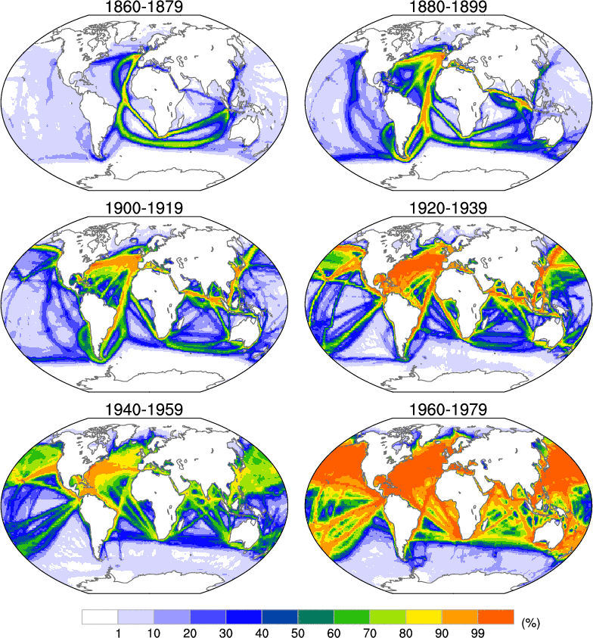
Data Coverage from Ships of Opportunity
SST,
Air temp,
Pressure,
Wind,
Cloudiness,
Humidity
% of months with at least
1 observation in a 2 x 2 degree box

Slide 3
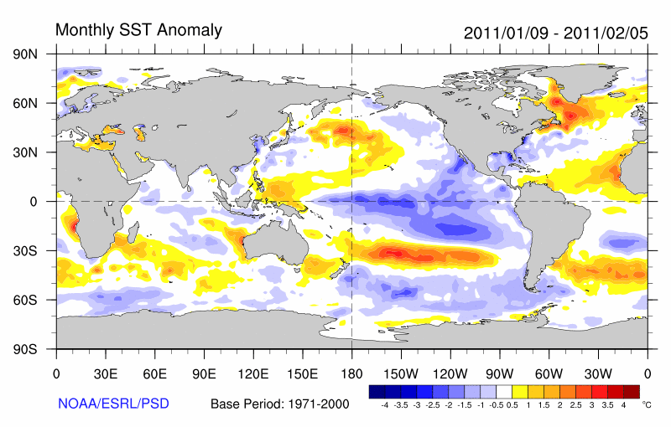
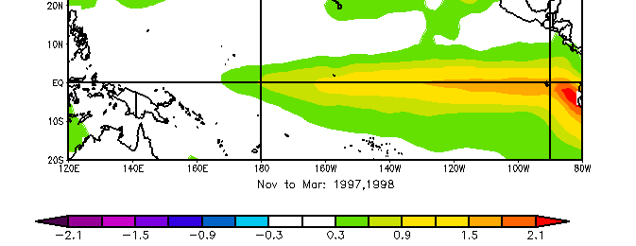
SST Anomaly over the last month
La Niña: cold in the Tropical Pacific
ships + satellite data + floats + buoys

Slide 4
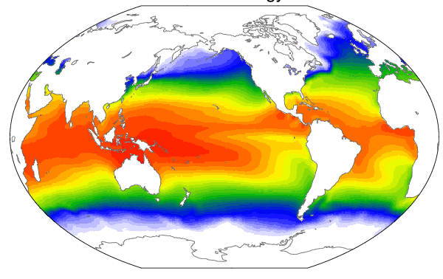
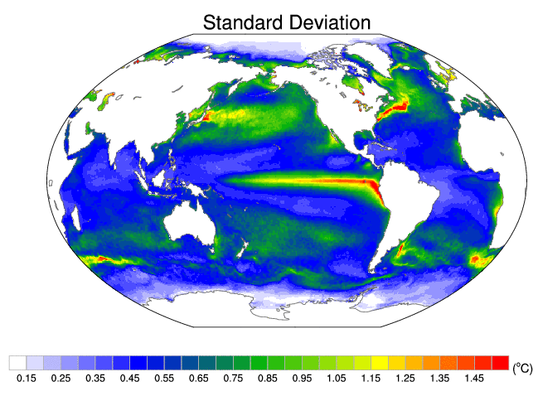
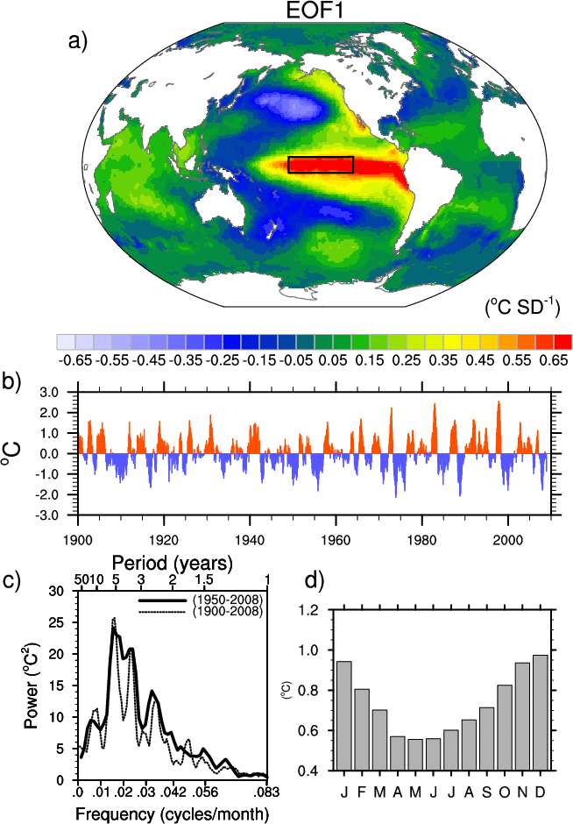
Mean SST and Measures of its variability
SST Climatology Jan
1982-2008 monthly ¼ deg
Equatorial Cold Tongue
“Nino 3.4”

Slide 5
Why is it called El Nino?
Originally named by Peruvian fisherman
For very warm water in the Pacific Ocean, occurring around Christmas.
El Niño means The Little One in Spanish. (Christ Child).
El Niño has now come to mean a much larger event that occurs about every 3-7 years across the tropical Pacific Ocean

Slide 6
What is El Niño and ENSO?
Interaction between the atmosphere and ocean across the tropical Pacific
Causes big changes in
  Ocean temperatures (warms in event)
  Winds
  Thermocline depth, ocean currents and upwelling
    Involves Rossby and Kelvin waves
  Precipitation (Convection)
  Sea Level Pressure (SLP)
    East-west SLP dipole called “Southern Oscillation”
    El Niño + Southern Oscillation: “ENSO”

Slide 7
ENSO SST Variability in Nin03.4 region
SST Anomaly Time series
Standard deviation by month
Spectra

Slide 8
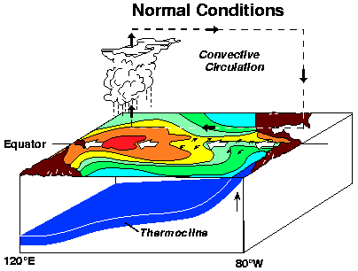
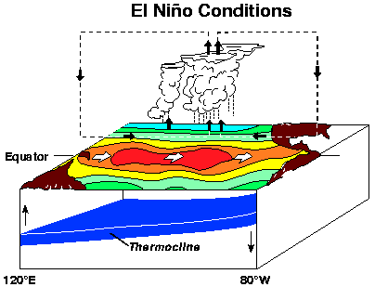
El Niño: Atmosphere-Ocean Interaction in the Tropical Pacific

Slide 9
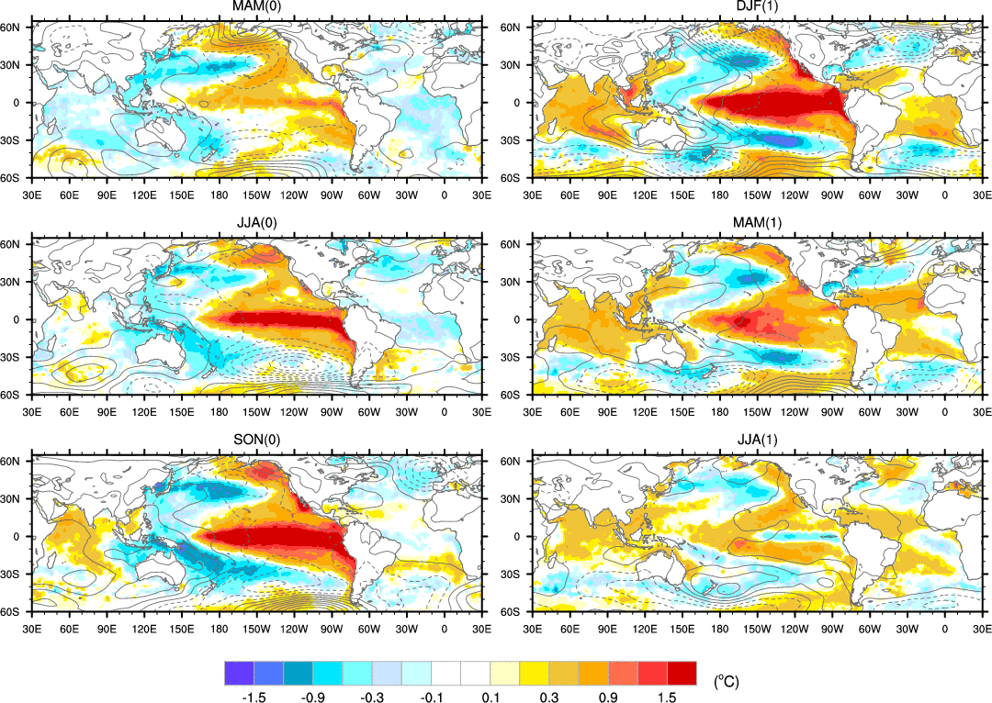
Global ENSO evolution (warm phase)
SST
SLP, contour

Slide 10
Precipitation
El Niño Anomalies
La Niña Anomalies (opposite of El Niño)
Red more precipitation, blue les precipitation

Slide 11
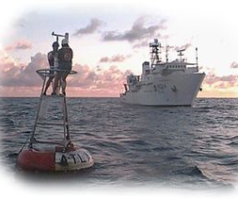
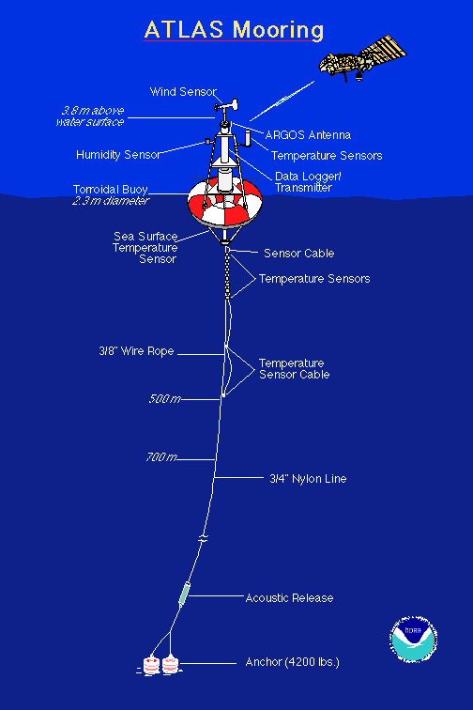

Tropical Atmosphere Ocean (TAO) Buoy
http://www.pmel.noaa.gov/tao/index.shtml

Slide 12
Hovmoller Diagram of Anomalous SST and
Zonal (east-west) winds 1997-1998

Slide 13
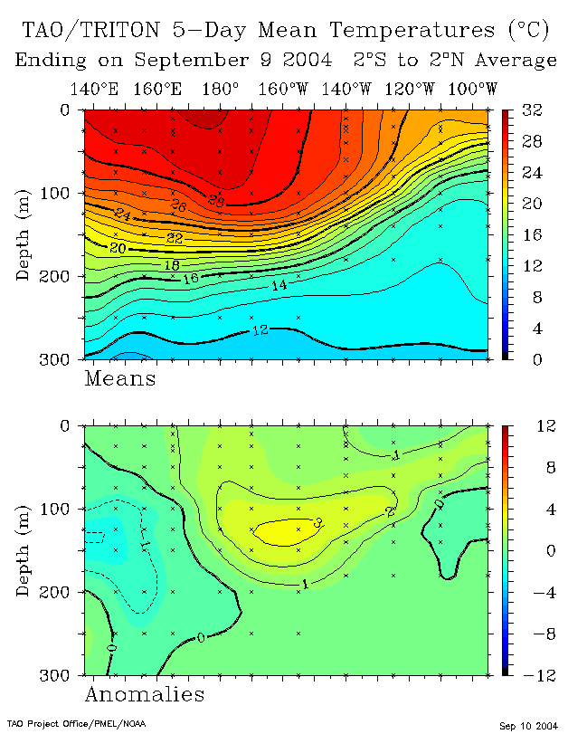
Temperature along the equator in the Pacific
thermocline
Anomaly
September 2004
September 2010
From TOGA-Tao Array

Slide 14
Ocean
Temperature
Anomalies
Sea level height
thermocline
Thermocline
upwelling

Slide 15
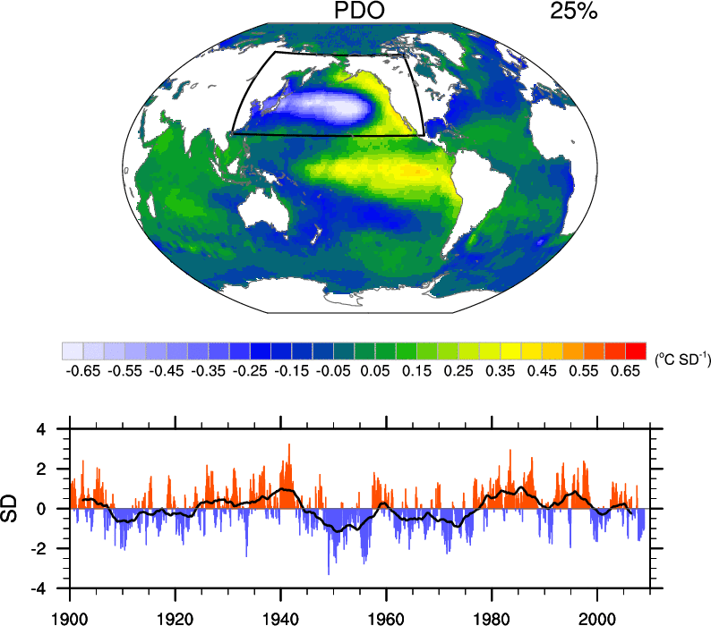
The Pacific Decadal Oscillation (PDO)
First EOF of
North Pacific SST
“PDO” –
based on fluctuations in the times series that goes with the first EOF
Color bars monthly values, line 5-year running mean
Notes:
First empirical orthogonal function (EOF) analysis, also referred to as principal component analysis to find the leading pattern of SST variability in the north Pacific (rectangle). The time series associated with this pattern, know as the first principal component, gives the sign and amplitude of the pattern at a given time. The map I the figure above is generated by regressing the SST anomalies at a given point on the time series. This recovers the EOF pattern in the North Pacific but also shows how the PDO (based on the low frequency variability in the bottom panel) is related to SST anomalies over the globe.

Slide 16
What Causes the PDO and Pacific Variability in General?
Signal from the Tropics?
  Midlatitude ocean integrates ENSO signal
  decadal variability in the ENSO region
Random forcing by the Atmosphere
  Aleutian low => underlying ocean
Midlatitude Dynamics
  Shifts in the strength/position of the ocean gyres
  Could include feedbacks with the atmosphere

Slide 17
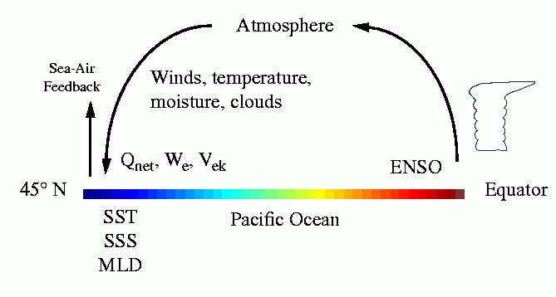
“The Atmospheric Bridge”
Meridional cross section through the central Pacific
(Alexander 1992; Lau and Nath 1996; Alexander et al. 2002 all J. Climate)
Notes:
Atmospheric bridge: The atmospheric response to ENSO influences oceans far from the tropical Pacific via changes in the atmosphere

Slide 18
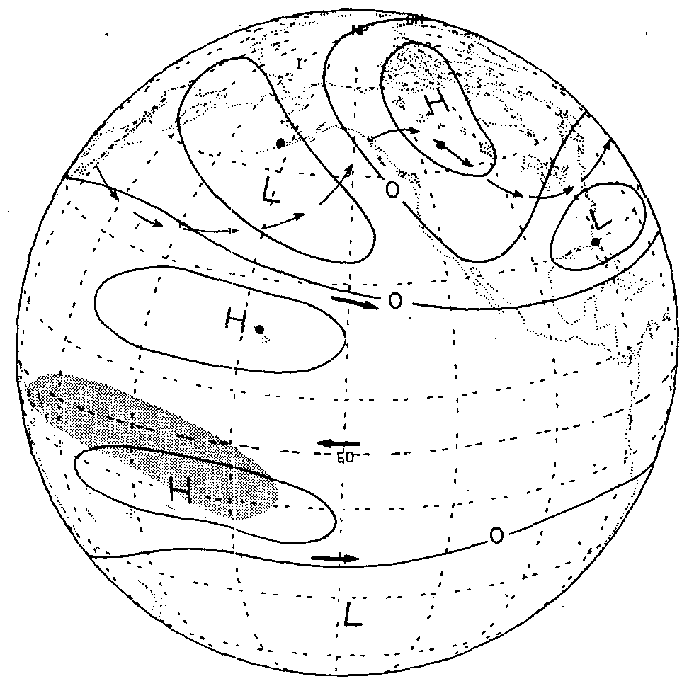
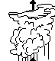
Mechanism for Atmospheric Circulation Changes due to ENSO
Atmospheric Rossby wave forced by tropical heating
Latent heat
release in
thunderstorms
Warm SST
Horel and Wallace, Mon. Wea Rev. 1981

Slide 19
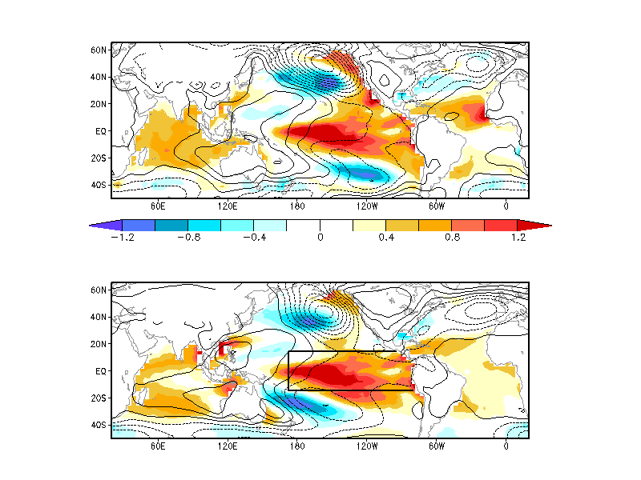
El Niño – La Niña Composite:
DJF SLP Contour (1 mb); FMA SST (shaded ºC)
Obs
L
Model
Notes:
Based on 9 El Niño Events and 9 La Niña events over the period 1950-99. From Alexander et al. (2002 J. Climate). Model atmospheric general circulation model coupled to a mixed layer ocean model except in the tropical Pacific (box) where SSTs are specified over the period 1950-1999. Model results are based on the ensemble average of the 16 simulations. ENSO peaks around December. The atmospheric circulation responds to the tropical Pacific SST anomalies rapidly (~2 weeks). The ocean takes 2-6 months to integrate the forcing and create large SST anomalies.

Slide 20
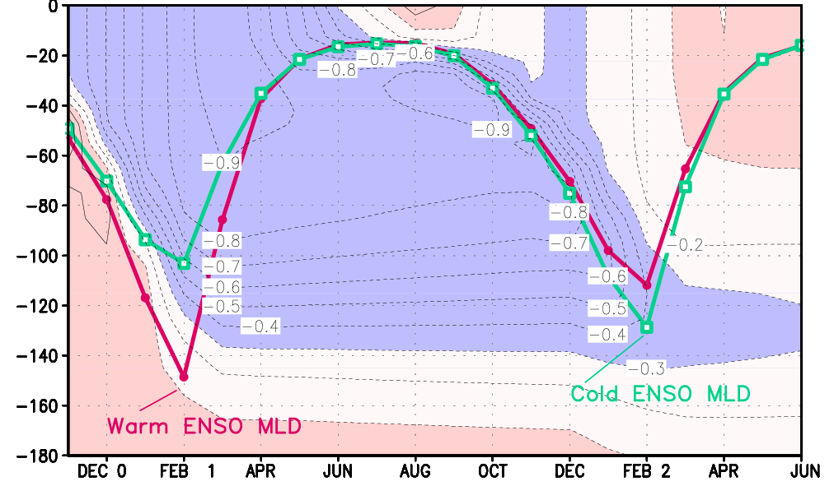
Upper Ocean: Temperature and mixed layer depth
El Niño – La Niña model composite: Central North Pacific
Alexander et al. 2002, J. Climate

Slide 21
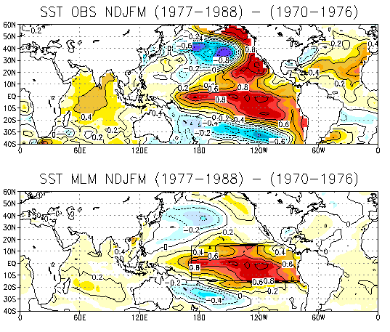
“Decadal” variability in the North Pacific: tropical (ENSO) Connection?
Observed SST Nov-Mar (1977-88) – (1970-76)
MLM SST Nov-Mar (1977-88) – (1970-76)
Notes:
Bottom atmospheric model coupled to a mixed layer model (MLM) in the ocean; results are based on an ensemble average of 16 simulations. It is likely that at least one of the runs have larger amplitude anomalies, that are averaged out in the ensemble mean.

Slide 22
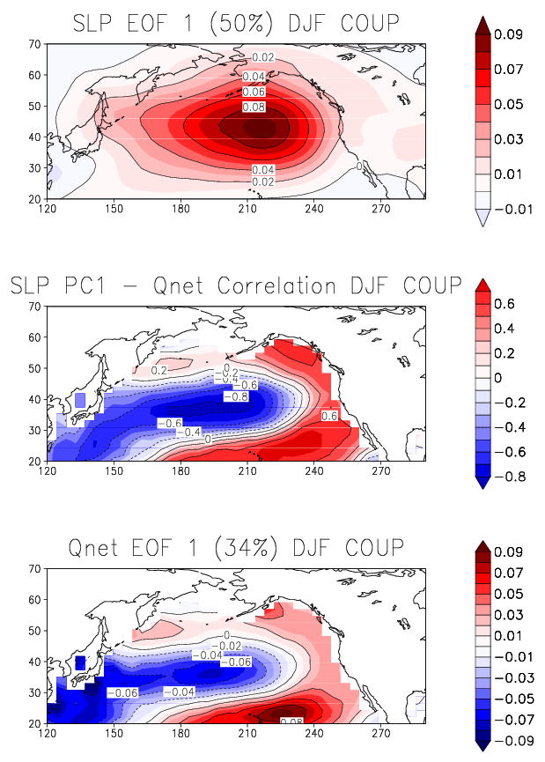
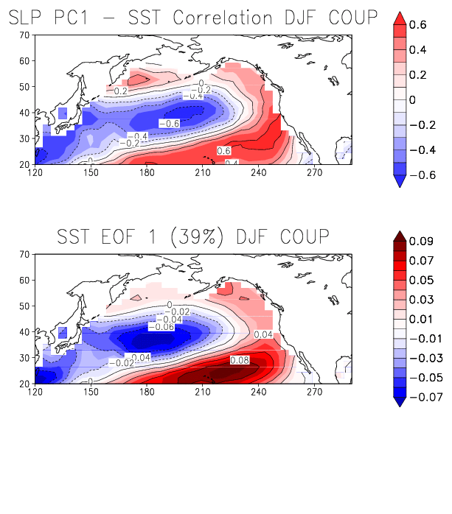
Aleutian Low Impact on Fluxes & SSTs (DJF)
Leading Patterns of Variability AGCM-MLM
EOF 1 SLP (50%)
SLP PC1 - SST correlation
SLP PC1 - Qnet correlation
EOF 1 SST (34%)
Notes:
These pictures are based on an atmospheric general circulation model coupled to a thermodynamic ocean
Model. The ocean model does not have currents, so no ENSO and no subtropical ocean gyres. The two
panels on the left are also very similar to a simulation in which the atmosphere is not coupled to an ocean,
Indicating that the Aleutian low variability and the associated fluxes are generated by internal atmospheric
processes.
Empirical Orthogonal Functions (EOFS) is a statistical technique for isolating patterns. The time series that accompanies
The EOF which indicates its amplitude and polarity at any time is often called the Principal component (PC).
Qnet is the net surface heat flux between the atmosphere and ocean. (%) - indicates the percent variance
explained by the EOF.

Slide 23
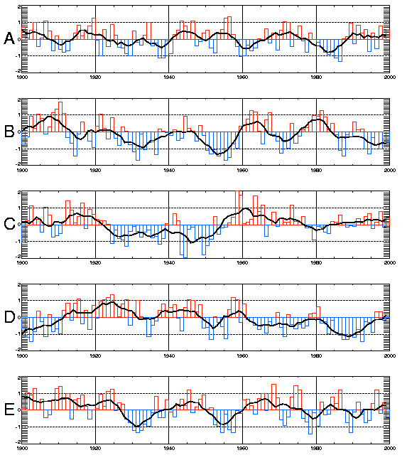
PDO or slab ocean forced by noise?
Use PDO timeseries
To estimate F and λ in the stocashtic model and then generate stochastic model time series:
4 of the 5 on the left are from a stochastic model
One is the PDO displayed in reverse order
Not shown: stochastic model or red noise spectra good fit to PDO time series
From David Pierce 2001, Progress in Oceanography
Notes:
1 of the 5 time series above is the PDO time series plotted in reverse chronological order. The other four where generated using the concept of a slab ocean forced by white noise. The synthetic time series are generated to have the same correlation with lag of 1 yr (Auto-regressive 1 lag AR1 process) as the real time series.
Oh – the real PDO is curve C.

Slide 24
Pacific Ocean Surface Currents
Subtropical
Gyre
Subtropical
Gyre
Surface currents mainly driven by wind
Notes:
Annual average ocean currents (m s⁻¹) averaged over the upper 500 m from the Simple Ocean Data Assimilation (SODA, Carton and Giese, 2008) for the years 1958-2001. The current strength is indicated by the three tone gray scale with maximum values of ~0.7 m sec⁻¹ in the Kuroshio.

Slide 25
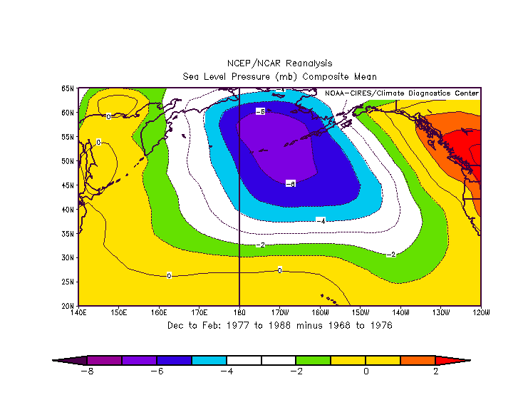
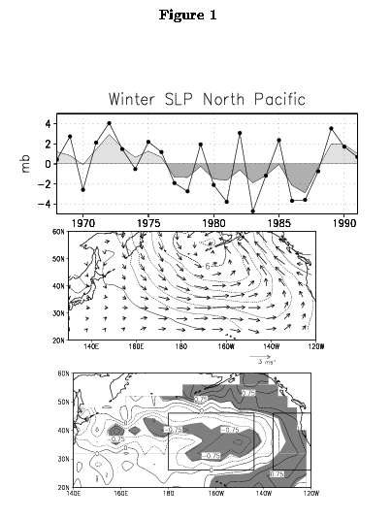
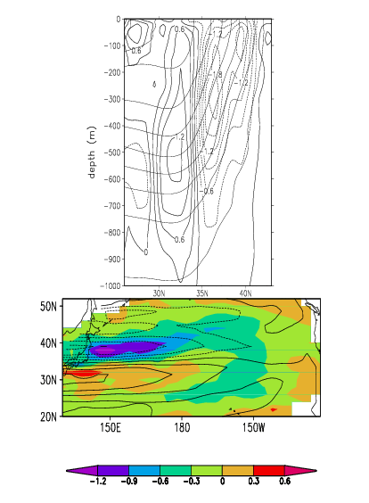
Ocean Response to Change in Wind Stress
SLP 1977-88 - 1968-76
Contours: geostrophic flow from change in wind stress
Shading: vertically integrated temperature (0-450 m): 1982-90 – 1970-80
Deser, Alexander & Timlin 1999 J. Climate
Notes:
Latif and Banett mechanism would have predicted warming east of Japan after the strengthening in the Aleutian low that occurred in 1976. The associated changes in the wind would spin up the ocean currents bringing more warm water near to Japan. However, not only did the wind forcing strengthen but it moved south as a result the warming occurred south of Japan, while east of Japan cooled significantly.

Slide 26
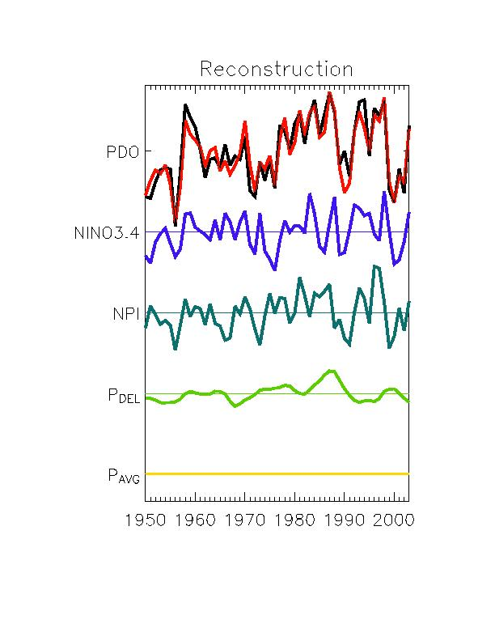
PDO Reconstruction
All time
scales
>8years
Black- actual PDO
Red- reconstructed
85%
75%
Forcings (F)
Atmosphere bridge
41%
20%
Random fluctuations of Aleutain low
38%
31%
Change in
the ocean gyre
7%
24%
Percent explained by each process
Schneider and Cornuelle 2005 J Climate
Notes:
PDO Index - Black line & Reconstruction of the PDO index (red line)
Reconstruction based on 4 factors:
Memory (correlation with previous time) - thermal inertia
ENSO forcing through the atmospheric bridge
Forcing via random variations in the Aleutian Low or North Pacific Index (NPI)
Changes in te ocean circulation, given by pressure difference I pressure gradient (P del)
Numbers to right of graph indicate % of the PDO variance explained, left most column variance explained at low frequency

Slide 27
PDO: Multiple Causes?
Interannual timescales:
  Integration of noise (Fluctuations of the Aleutian Low)
  Response to ENSO (Atmospheric bridge)
    Plus reemergence
Decadal timescales (% of Variance)
  Integration of noise (1/3)
  Response to ENSO (1/3)
  Ocean dynamics (1/3)
  Predictable out to (but not beyond) 1-2 years
    We developed a statistical method gives skillful PDO prediction out ~1 year
Trend
  Perhaps some signal in the PDO
  Likely associated with Global warming

Slide 28
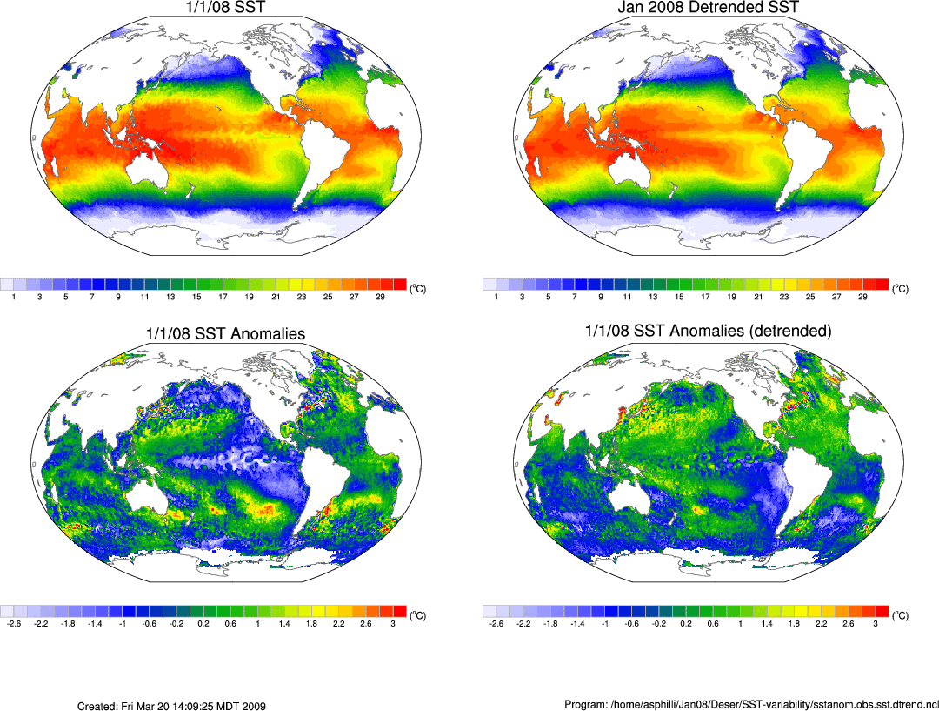
Sea Surface Temperature Jan 1, 2008
SST Climatology 1982-2008 Jan
Equatorial Cold Tongue
Anomalous Sea Surface Temperature Jan 1, 2008
¼ degree satellite data

Slide 29
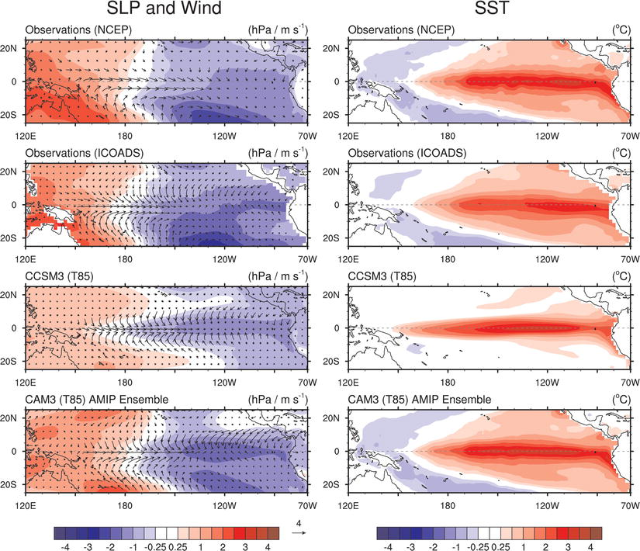
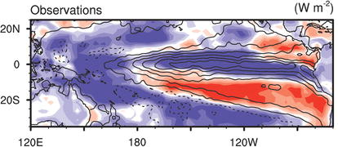
What causes SST to warm? Not local winds and not heat exchange w/atm

Slide 30
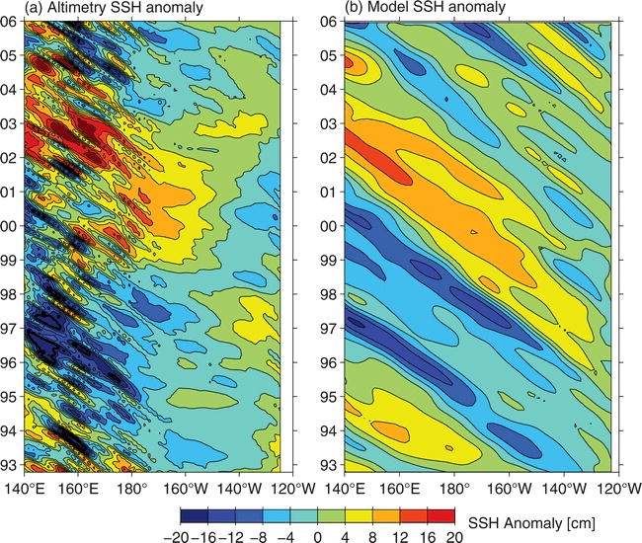
Rossby wave propagation
Qiu et al. 2007
Notes:
SSH anomalies along the zonal band of 32ｰ�34ｰN from (a) the satellite altimeter data and (b) the wind-forced baroclinic Rossby wave model;

Slide 31
ENSO Mechanisms
Why does ENSO occur?
What sets the time scale of variability?
Coupled Ocean-Atmosphere Dynamics
Thermocline Depth/Upwelling
Oceanic waves
Recharge Oscillator Paradigm
Noise-forced Paradigm

Slide 32
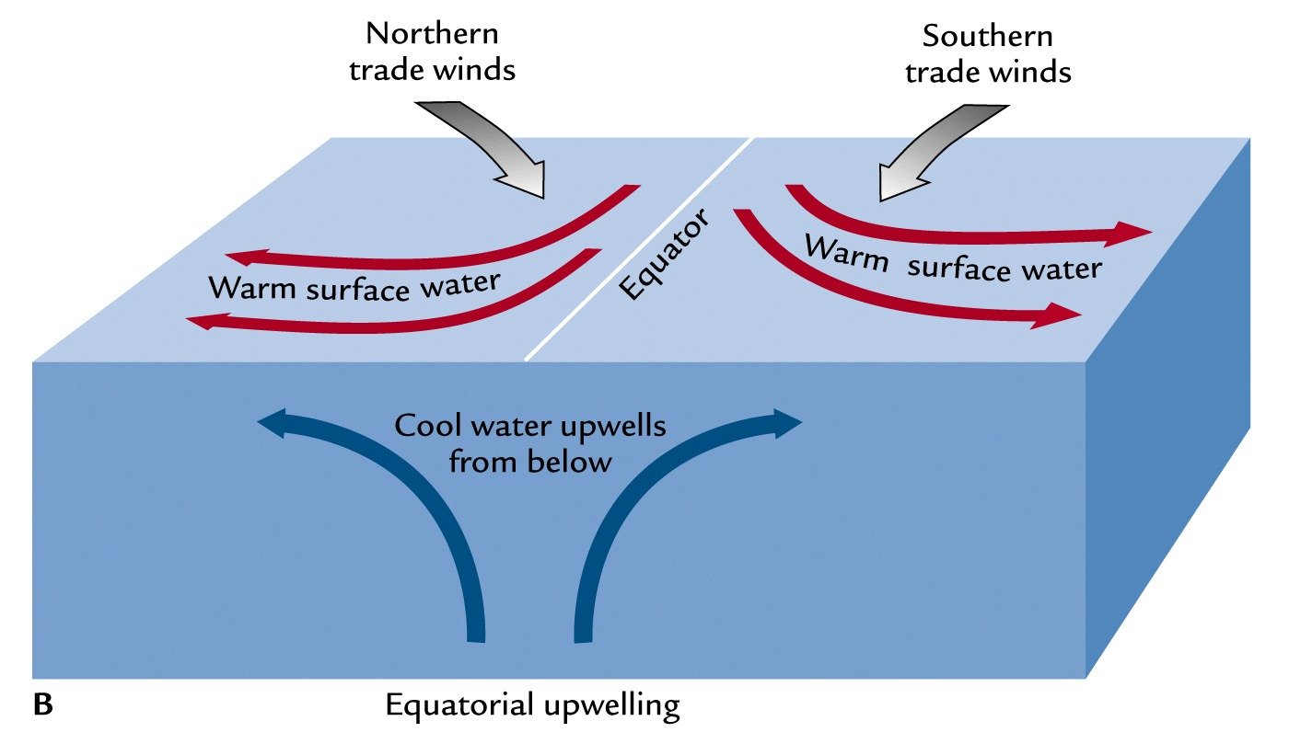

Slide 33
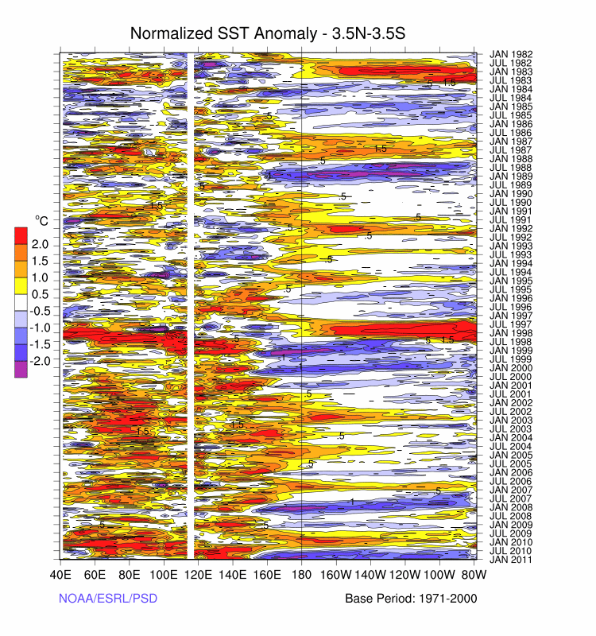
Hovmöller Diagram of SSTA along the equator in the Pacific and Indian Oceans

Slide 34
Wind Generated Rossby Waves
L
Atmosphere
ML
Ocean
Thermocline
Rossby
Waves
West
East
After waves pass ocean currents adjust
Waves change thermocline depth, if mixed layer reaches that depth, cold water can be mixed to the surface
Notes:
Wind sterss curl

